Slide 1
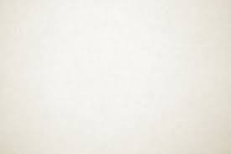
Just-a-Trim Task List
A bunch of things that I can think of that should dramatically improve the polish of the game.
Feel free to tackle these at your own pace. :)

Slide 2
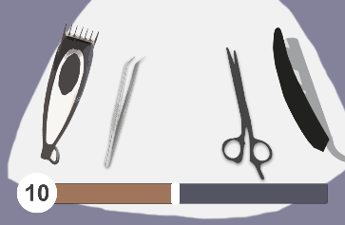
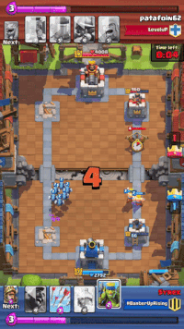

Hair Bar
At the moment, the hair bar movement increases and decreases in a staggered way. Is there a way to have smooth continuous fill like below?
It would be sweet if we could do something like this but only when decreasing…
Observe the little alpha bar before it’s fully filled. This will be a really good way to make keeping that bar low satisfying in Just-a-Trim!
Note this would only need to appear when decreasing not increasing.
Note the animation of the number bouncing when increasing. This would be a nice touch for us too!
Rolling numbers like this within our score system would be really satisfying to see. This gives players a real sense of progression / forward motion.

Slide 3
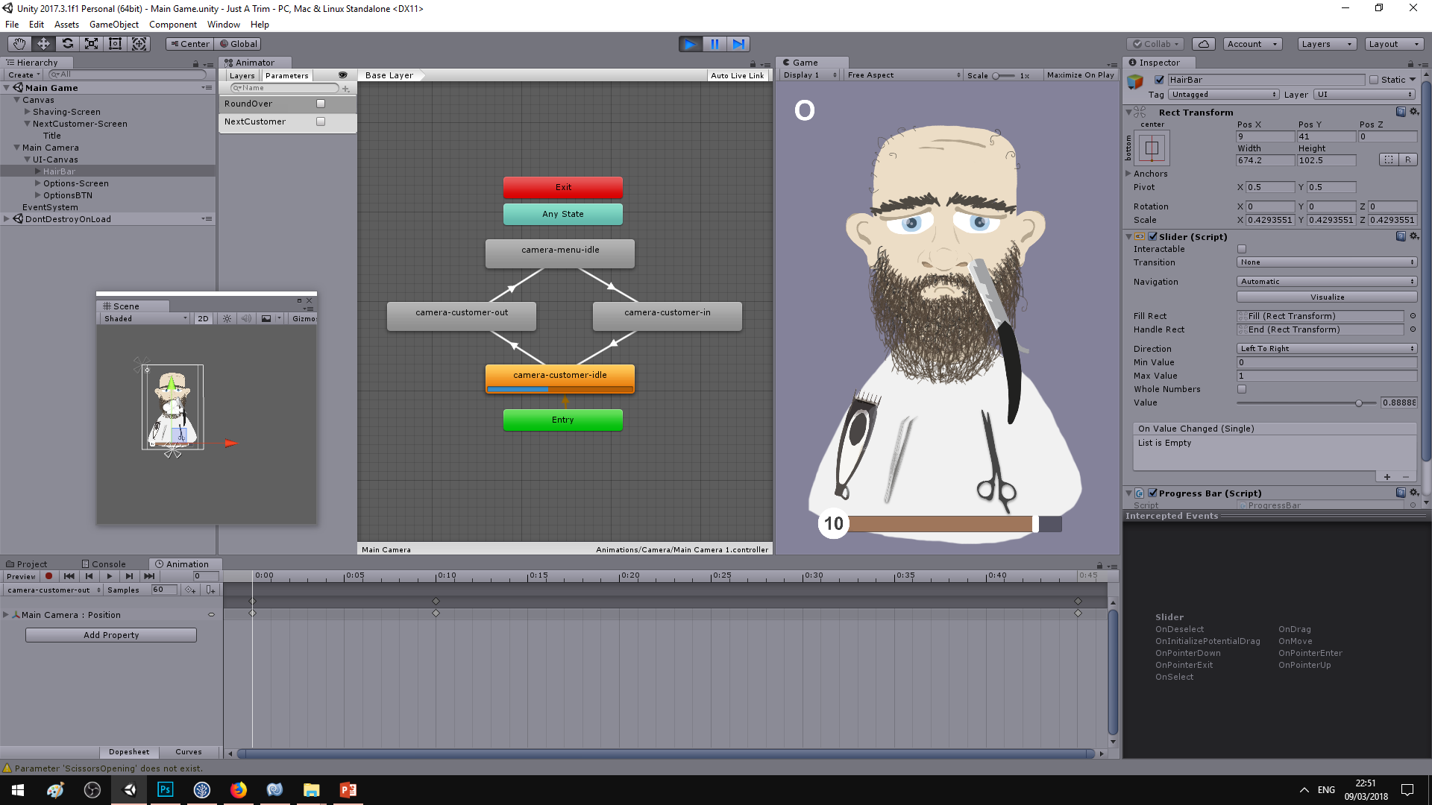
Shaving
I’m thinking the moment you release the right mouse button to shave, a quick animation of the tool plays before it spawns down the bottom.
It would be cool if when you shaved chunks of beard appeared and moved towards the score UI next to the

